Slide 1
Biological Modeling of Neural Networks
Week 8 – part 1 :Variation of membrane potential
8.1 Variation of membrane potential
- white noise approximation
8.2 Autocorrelation of Poisson
8.3 Noisy integrate-and-fire
- superthreshold and subthreshold
8.4 Escape noise
- stochastic intensity
8.5 Renewal models
8.6 Comparison of noise models
Week 8 – Noisy input models:
Barrage of spike arrivals
Wulfram Gerstner
EPFL, Lausanne, Switzerland

Slide 2
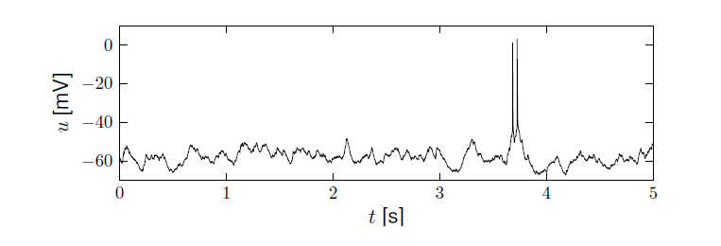
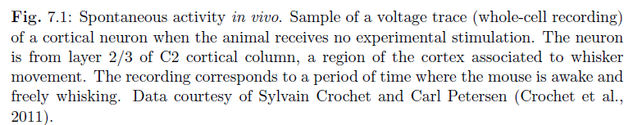
Neuronal Dynamics – 8.1 Review: Variability in vivo
Variability
- of membrane potential?
- of spike timing?
Spontaneous activity in vivo
awake mouse, cortex, freely whisking,
Crochet et al., 2011

Slide 3
Neuronal Dynamics – 8.1 Review. Variability
Fluctuations
of membrane potential
of spike times
In vivo data
→ looks ‘noisy’
In vitro data
→ fluctuations
fluctuations=noise?
relevance for coding?
source of fluctuations?
model of fluctuations?

Slide 4
Neuronal Dynamics – 8.1. Review Sources of Variability
- Intrinsic noise (ion channels)
Finite number of channels
Finite temperature
Na⁺
K⁺
Network noise (background activity)
Spike arrival from other neurons
Beyond control of experimentalist
Check intrinisic noise by removing the network

Slide 5
Neuronal Dynamics – 8.1. Review: Sources of Variability
- Intrinsic noise (ion channels)
In vivo data
→ looks ‘noisy’
In vitro data
→small fluctuations
→nearly deterministic
Na⁺
small contribution!
K⁺
Network noise
big contribution!

Slide 6
Neuronal Dynamics – 8.1 Review: Calculating the mean
mean: assume Poisson process
use for exercises
rate of inhomogeneous
Poisson process

Slide 7
Neuronal Dynamics – 8.1. Fluctuation of potential
for a passive membrane, predict
-mean
variance
of membrane potential fluctuations
Passive membrane
Passive membrane
=Leaky integrate-and-fire
without threshold

Slide 8
Neuronal Dynamics – 8.1. Fluctuation of current/potential
Synaptic current pulses of shape α
Blackboard,
Math detour:
White noise
EPSC
Passive membrane
I(t)
Fluctuating input current

Slide 9
Neuronal Dynamics – 8.1 Calculating autocorrelations
I(t)
Autocorrelation
Fluctuating input current
Blackboard,
Math detour
Mean:

Slide 10
White noise: Exercise 1.1-1.2 now
Assumption:
far away from theshold
Input starts here
Next lecture:
9:56
Expected voltage at time t
Variance of voltage at time t

Slide 11
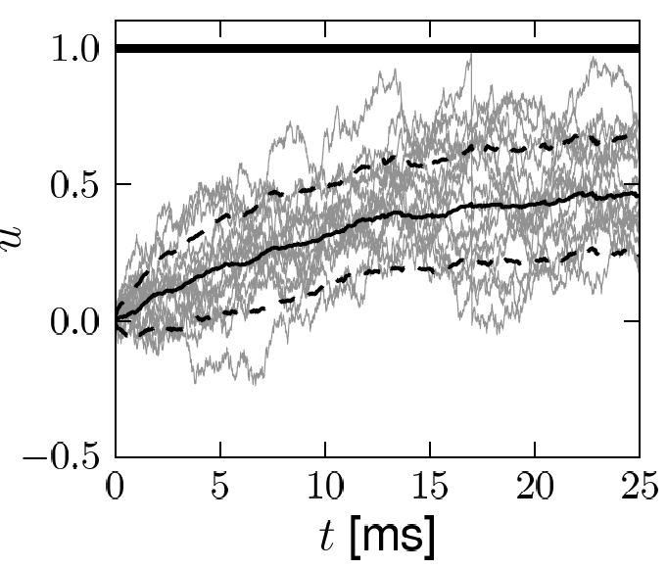
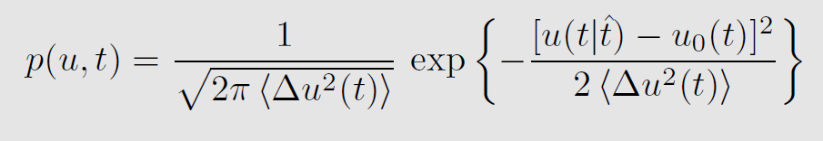
Diffusive noise (stochastic spike arrival)
Math argument

Slide 12
Neuronal Dynamics – 8.1 Calculating autocorrelations
Blackboard,
Math detour
Mean:
Autocorrelation
rate of inhomogeneous
Poisson process

Slide 13
Exercise 2.1-2.3 now: Diffusive noise (stochastic spike arrival)
Stochastic spike arrival:
excitation, total rate
Next lecture:
9h58
Synaptic current pulses
Assume that for t>0 spikes arrive stochastically with rate
Calculate mean voltage
u
2. Assume autocorrelation
- Calculate

Slide 14
Poisson spike arrival: Mean and autocorrelation of filtered signal
Filter
Assumption:
stochastic spiking
rate
mean
Autocorrelation of output
Autocorrelation of input

Slide 15
Biological Modeling of Neural Networks
Week 8 – part 2 : Autocorrelation of Poisson Process
8.1 Variation of membrane potential
- white noise approximation
8.2 Autocorrelation of Poisson
8.3 Noisy integrate-and-fire
- superthreshold and subthreshold
8.4 Escape noise
-renewal model
Week 8 – Variability and Noise:
Autocorrelation
Wulfram Gerstner
EPFL, Lausanne, Switzerland

Slide 16
Justify autocorrelation of spike input:
Poisson process in discrete time
Stochastic spike arrival:
Blackboard
In each small time step
Prob. Of firing
Firing independent between one time step and the next

Slide 17
Exercise 2 now: Poisson process in discrete time
Stochastic spike arrival:
excitation, total rate
Next lecture:
10:46
In each small time step
Prob. Of firing
Firing independent between one time step and the next
Show that autocorrelation
for
Show that in an a long interval of duration T,
the expected number of spikes is

Slide 18
Neuronal Dynamics – 8.2. Autocorrelation of Poisson
math detour
now!
Probability of spike
in step n AND step k
spike train
Probability of spike in time step:
Autocorrelation (continuous time)

Slide 19
Quiz – 8.1. Autocorrelation of Poisson
The Autocorrelation (continuous time)
Has units
[ ] probability (unit-free)
[ ] probability squared (unit-free)
[ ] rate (1 over time)
[ ] (1 over time)-squred
spike train

Slide 20
Biological Modeling of Neural Networks
Week 8 – part 3 : Noisy Integrate-and-fire
8.1 Variation of membrane potential
- white noise approximation
8.2 Autocorrelation of Poisson
8.3 Noisy integrate-and-fire
- superthreshold and subthreshold
8.4 Escape noise
-renewal model
Week 8 – Variability and Noise:
Autocorrelation
Wulfram Gerstner
EPFL, Lausanne, Switzerland

Slide 21
Neuronal Dynamics – 8.3 Noisy Integrate-and-fire
for a passive membrane, we can analytically predict the mean of membrane potential fluctuations
Passive membrane
Passive membrane
=Leaky integrate-and-fire
without threshold
ADD THRESHOLD
→ Leaky Integrate-and-Fire

Slide 22
Neuronal Dynamics – 8.3 Noisy Integrate-and-fire
effective noise current
I
u(t)
LIF
noisy input/
diffusive noise/
stochastic spike
arrival

Slide 23
Neuronal Dynamics – 8.3 Noisy Integrate-and-fire
fluctuating input current
I(t)
Random spike arrival
fluctuating potential

Slide 24
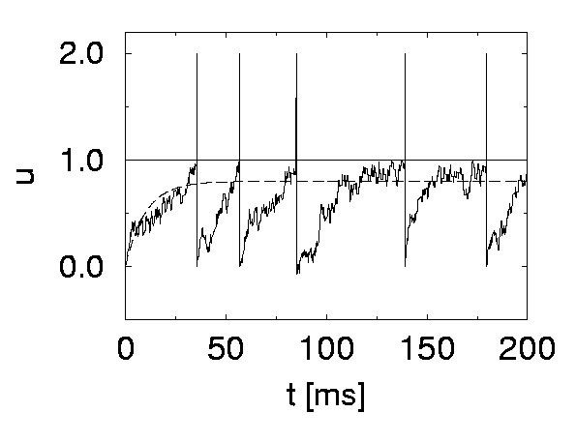
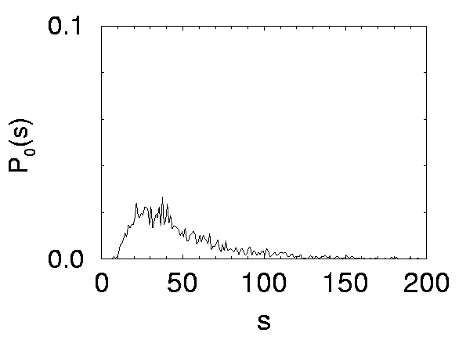
Neuronal Dynamics – 8.3 Noisy Integrate-and-fire
stochastic spike arrival in I&F – interspike intervals
I
ISI distribution
white noise

Slide 25
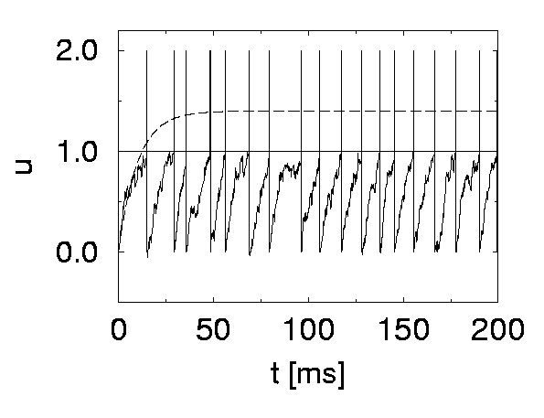
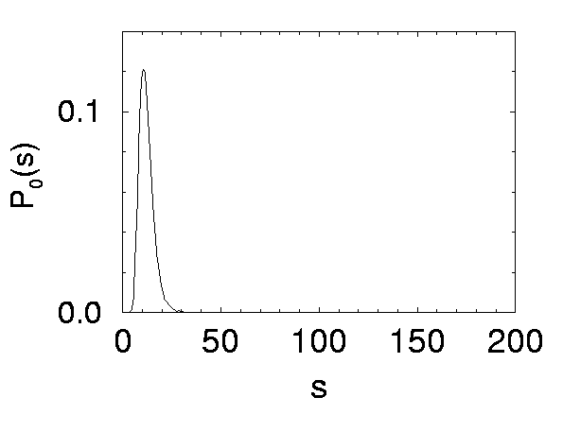
Neuronal Dynamics – 8.3 Noisy Integrate-and-fire
Superthreshold vs. Subthreshold regime

Slide 26
Neuronal Dynamics – 8.3. Stochastic leaky integrate-and-fire
noisy input/ diffusive noise/
stochastic spike arrival
u(t)
subthreshold regime:
- firing driven by fluctuations
- broad ISI distribution
- in vivo like
ISI distribution

Slide 27
Neuronal Dynamics – review- Variability in vivo
Spontaneous activity in vivo
Variability
of membrane potential?
awake mouse, freely whisking,
Crochet et al., 2011
Subthreshold regime

Slide 28
Neuronal Dynamics – 8.3 Summary:Noisy Integrate-and-fire
Stochastic spike arrival:
for a passive membrane, we can analytically predict the amplitude of membrane potential fluctuations
Passive membrane
Leaky integrate-and-fire
in subthreshold regime
→ In vivo like
fluctuating potential

Slide 29
Biological Modeling of Neural Networks
Week 8 – Noisy input models: barrage of spike arrivals
8.1 Variation of membrane potential
- white noise approximation
8.2 Autocorrelation of Poisson
8.3 Noisy integrate-and-fire
- superthreshold and subthreshold
THE END

Slide 30
Biological Modeling of Neural Networks
Week 8 – part 4 : Escape noise
8.1 Variation of membrane potential
- white noise approximation
8.2 Autocorrelation of Poisson
8.3 Noisy integrate-and-fire
- superthreshold and subthreshold
8.4 Escape noise
- stochastic intensity
8.5 Renewal models
8.6 Comparison of noise models
Week 8 – Noisy input models:
Barrage of spike arrivals
Wulfram Gerstner
EPFL, Lausanne, Switzerland

Slide 31
Neuronal Dynamics – Review: Sources of Variability
- Intrinsic noise (ion channels)
Finite number of channels
Finite temperature
Na⁺
small contribution!
K⁺
Network noise (background activity)
Spike arrival from other neurons
Beyond control of experimentalist
Noise models?
big contribution!

Slide 32
Noise models
escape process,
stochastic intensity
stochastic spike arrival
(diffusive noise)
u(t)
t
escape rate
noisy integration
Now:
Escape noise!
Relation between the two models:
later

Slide 33
Neuronal Dynamics – 8.4 Escape noise
escape process
escape rate
u(t)
t
escape rate
Example: leaky integrate-and-fire model
u

Slide 34
Neuronal Dynamics – 8.4 stochastic intensity
escape process
Escape rate = stochastic intensity
of point process
u(t)
t
escape rate
examples
u

Slide 35
Neuronal Dynamics – 8.4 mean waiting time
escape rate
u(t)
t
u
1ms
I(t)
mean waiting time, after switch
t
Blackboard,
Math detour

Slide 36
Neuronal Dynamics – 8.4 escape noise/stochastic intensity
Escape rate = stochastic intensity
of point process
u(t)
t

Slide 37
Neuronal Dynamics – Quiz 8.4
Escape rate/stochastic intensity in neuron models
[ ] The escape rate of a neuron model has units one over time
[ ] The stochastic intensity of a point process has units one over time
[ ] For large voltages, the escape rate of a neuron model always saturates
at some finite value
[ ] After a step in the membrane potential, the mean waiting time until a spike is fired is proportional to the escape rate
[ ] After a step in the membrane potential, the mean waiting time until a spike is fired is equal to the inverse of the escape rate
[ ] The stochastic intensity of a leaky integrate-and-fire model with reset only depends on the external input current but not on the time of the last reset
[ ] The stochastic intensity of a leaky integrate-and-fire model with reset depends on the external input current AND on the time of the last reset

Slide 38
Biological Modeling of Neural Networks
Week 8 – part 5 : Renewal model
8.1 Variation of membrane potential
- white noise approximation
8.2 Autocorrelation of Poisson
8.3 Noisy integrate-and-fire
- superthreshold and subthreshold
8.4 Escape noise
- stochastic intensity
8.5 Renewal models
Week 8 – Variability and Noise:
Autocorrelation
Wulfram Gerstner
EPFL, Lausanne, Switzerland

Slide 39
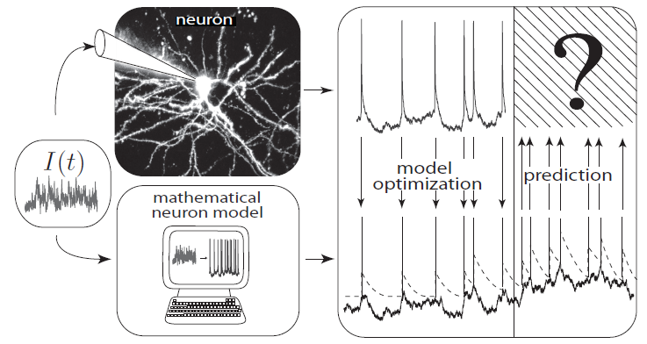
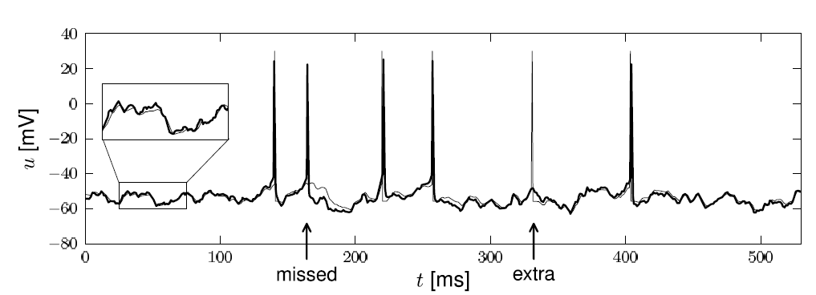
Neuronal Dynamics – 8.5. Interspike Intervals
t
deterministic part of input
noisy part of input/intrinsic noise
→ escape rate
Example:
nonlinear integrate-and-fire model
Example:
exponential stochastic intensity

Slide 40
Neuronal Dynamics – 8.5. Interspike Interval distribution
escape process
escape rate
u(t)
Survivor function
t
t
t

Slide 41
Neuronal Dynamics – 8.5. Interspike Intervals
escape process
Survivor function
Examples now
A
u(t)
t
escape rate
Interval distribution
escape
rate
Survivor function
u

Slide 42
Neuronal Dynamics – 8.5. Renewal theory
Example: I&F with reset, constant input
escape rate
Survivor function
1
Interval distribution

Slide 43
Neuronal Dynamics – 8.5. Time-dependent Renewal theory
Example: I&F with reset, time-dependent input,
escape rate
Survivor function
1
Interval distribution

Slide 44
Neuronal Dynamics – Homework assignement
neuron with relative refractoriness, constant input
escape rate
Survivor function
1
Interval distribution

Slide 45
Neuronal Dynamics – 8.5. Firing probability in discrete time
Probability to survive 1 time step
Probability to fire in 1 time step

Slide 46
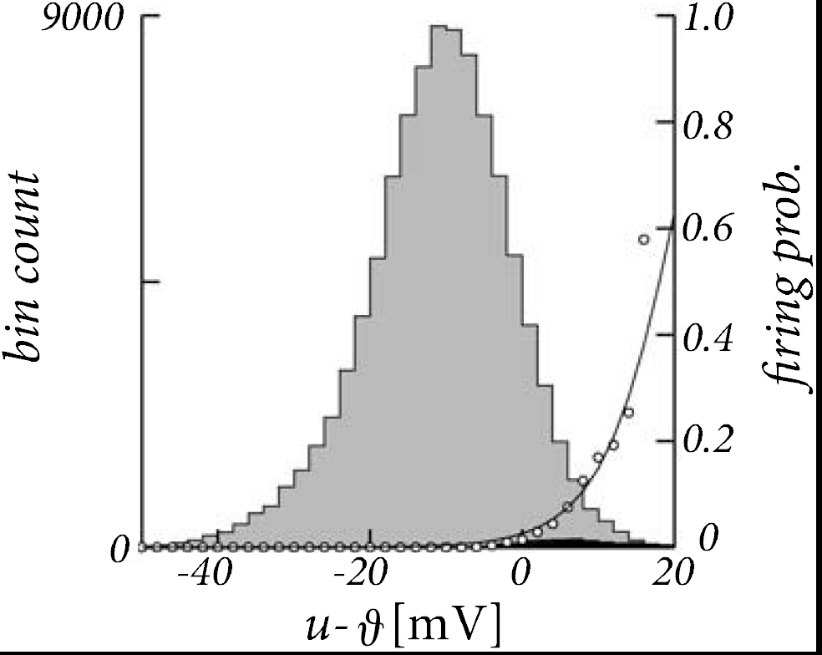
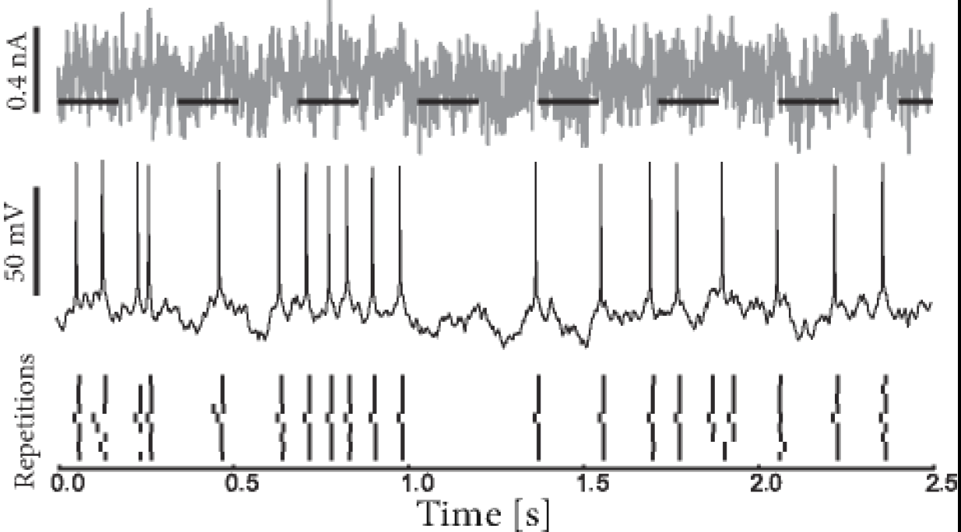
Neuronal Dynamics – 8.5. Escape noise - experiments
Jolivet et al. ,
J. Comput. Neurosc.
2006
escape rate

Slide 47
Neuronal Dynamics – 8.5. Renewal process, firing probability
Escape noise = stochastic intensity
Renewal theory
- hazard function
- survivor function
- interval distribution
time-dependent renewal theory
discrete-time firing probability
Link to experiments
→ basis for modern methods of
neuron model fitting

Slide 48
Biological Modeling of Neural Networks
Week 8 – part 6 : Comparison of noise models
8.1 Variation of membrane potential
- white noise approximation
8.2 Autocorrelation of Poisson
8.3 Noisy integrate-and-fire
- superthreshold and subthreshold
8.4 Escape noise
- stochastic intensity
8.5 Renewal models
8.6 Comparison of noise models
Week 8 – Noisy input models:
Barrage of spike arrivals
Wulfram Gerstner
EPFL, Lausanne, Switzerland

Slide 49
Neuronal Dynamics – 8.6. Comparison of Noise Models
escape process
(fast noise)
stochastic spike arrival
(diffusive noise)
u(t)
t
escape rate
noisy integration

Slide 50
Poisson spike arrival: Mean and autocorrelation of filtered signal
Filter
Assumption:
stochastic spiking
rate
mean
Autocorrelation of output
Autocorrelation of input

Slide 51
Diffusive noise (stochastic spike arrival)
Stochastic spike arrival:
excitation, total rate Re
inhibition, total rate Ri
Synaptic current pulses
EPSC
IPSC
Blackboard
u
Langevin equation,
Ornstein Uhlenbeck process

Slide 52
Diffusive noise (stochastic spike arrival)
Math argument:
- no threshold
- trajectory starts at
known value

Slide 53
Diffusive noise (stochastic spike arrival)
Math argument

Slide 54
Neuronal Dynamics – 8.6. Diffusive noise/stoch. arrival
A) No threshold, stationary input
Membrane potential density: Gaussian
u
u
constant input rates
no threshold
p(u)
noisy integration

Slide 55
Neuronal Dynamics – 8.6 Diffusive noise/stoch. arrival
B) No threshold, oscillatory input
Membrane potential density:
Gaussian at time t
u
u
p(u(t))
noisy integration

Slide 56
Neuronal Dynamics – 6.4. Diffusive noise/stoch. arrival
C) With threshold, reset/ stationary input
Membrane potential density
u
u
p(u)

Slide 57
Neuronal Dynamics – 8.6. Diffusive noise/stoch. arrival
Superthreshold vs. Subthreshold regime
u
p(u)
p(u)
Nearly Gaussian
subthreshold distr.
Image:
Gerstner et al. (2013)
Cambridge Univ. Press;
See: Konig et al. (1996)

Slide 58
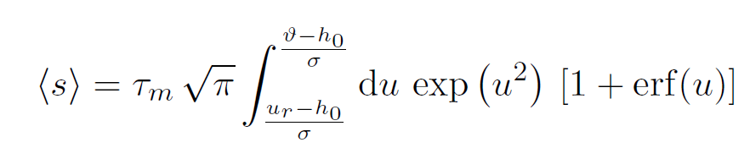
Neuronal Dynamics – 8.6. Comparison of Noise Models
escape process
(fast noise)
stochastic spike arrival
(diffusive noise)
A
C
u(t)
t
Stationary input:
Mean ISI
Mean firing rate
escape rate
noisy integration
Interval distribution
noise
Siegert 1951
white
(fast noise)
synapse
(slow noise)
: first passage
time problem
escape
rate
(Brunel et al., 2001)
Survivor function

Slide 59
Neuronal Dynamics – 8.6 Comparison of Noise Models
Diffusive noise
- distribution of potential
- mean interspike interval
FOR CONSTANT INPUT
- time dependent-case difficult
Escape noise
- time-dependent interval
distribution

Slide 60
Noise models: from diffusive noise to escape rates
noisy integration
stochastic spike arrival
(diffusive noise)
escape rate

Slide 61
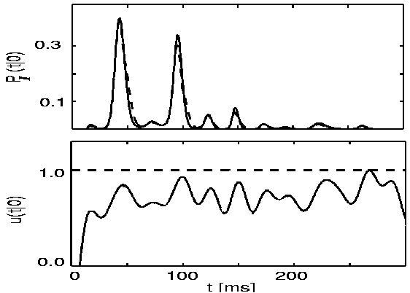
Comparison: diffusive noise vs. escape rates
Plesser and Gerstner (2000)
Probability of first spike
diffusive
escape
subthreshold
potential
escape rate

Slide 62
Neuronal Dynamics – 8.6 Comparison of Noise Models
Diffusive noise
- represents stochastic spike arrival
- easy to simulate
- hard to calculate
Escape noise
- represents internal noise
- easy to simulate
- easy to calculate
- approximates diffusive noise
- basis of modern model fitting methods

Slide 63
Neuronal Dynamics – Quiz 8.4.
A. Consider a leaky integrate-and-fire model with diffusive noise:
[ ] The membrane potential distribution is always Gaussian.
[ ] The membrane potential distribution is Gaussian for any time-dependent input.
[ ] The membrane potential distribution is approximately Gaussian for any time-dependent input,
as long as the mean trajectory stays ‘far’ away from the firing threshold.
[ ] The membrane potential distribution is Gaussian for stationary input in the absence of a threshold.
[ ] The membrane potential distribution is always Gaussian for constant input and fixed noise level.
B. Consider a leaky integrate-and-fire model with diffusive noise for time-dependent input. The above figure
(taken from an earlier slide) shows that
[ ] The interspike interval distribution is maximal where the determinstic reference trajectory is closest to the threshold.
[ ] The interspike interval vanishes for very long intervals if the determinstic reference trajectory
has stayed close to the threshold before - even if for long intervals it is very close to the threshold
[ ] If there are several peaks in the interspike interval distribution, peak n is always of smaller amplitude than peak n-1.
[ ] I would have ticked the same boxes (in the list of three options above)
for a leaky integrate-and-fire model with escape noise.

